Slide 1





Nonlinear Cavity Response under Coherent Excitation: Numerical and Experimental Investigation
Samuel Serna^{1,2}
Jeremy Oden¹, Xavier Le Roux², Philippe Delaye¹, Eric Cassan²,
Nicolas Dubreuil¹
¹Laboratoire Charles Fabry, Institut d'Optique Graduate School, Université Paris-Saclay, CNRS, France
²Institut d’Électronique Fondamentale, Univ. Paris-Sud, UMR 8622, Université Paris-Saclay, CNRS, France

Slide 2
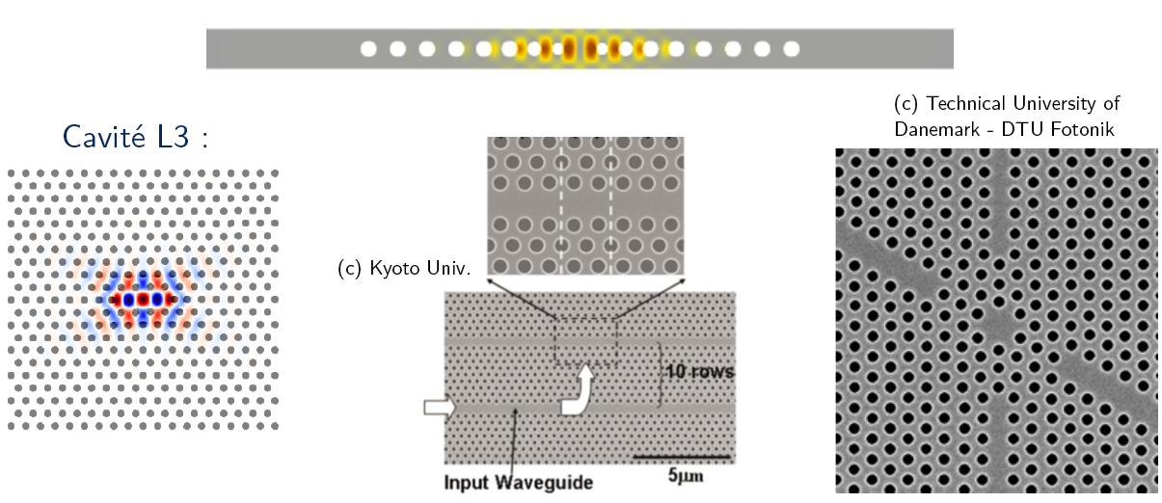
PhC Microcavities in Semi-Conductors
Strong light confinement
High density of energy stored in microcavities
Figure of Merit = Q/V
2

Slide 3
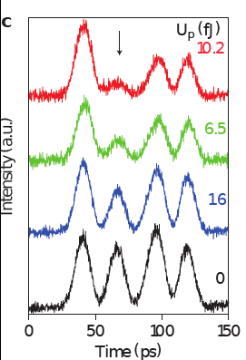
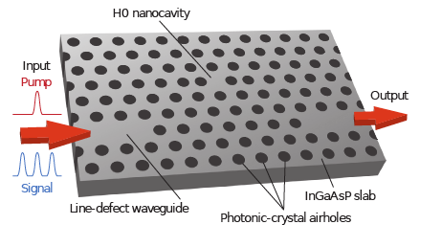
Nonlinear Optical Microcavities
All-optical switches in PhC semiconductor microcavities
InP :
F. Raineri et al., App. Phys. Lett 85, 1880 (2004)
Silicon :
Tanabe et al., App. Phys. Lett 87 151112 (2005)
GaAs :
E. Weidner, et al. Applied Physics Letters, 90, (2007), S. Combrié, et al. Opt. Lett., 33, 1908 (2008), C. Husko, et al. Appl. Phys. Lett., 94, 021111 (2009)
GaInP :
V. Eckhouse et al., Opt. Express 20, 8524 (2012)
InGaAsP :
Nozaki et al., Nat. Photon. 4, 248 (2012)
All-optical switching with pump energy of 10 fJ !
3

Slide 4
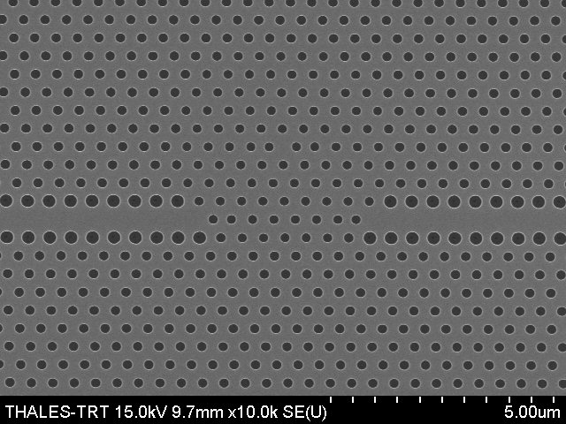
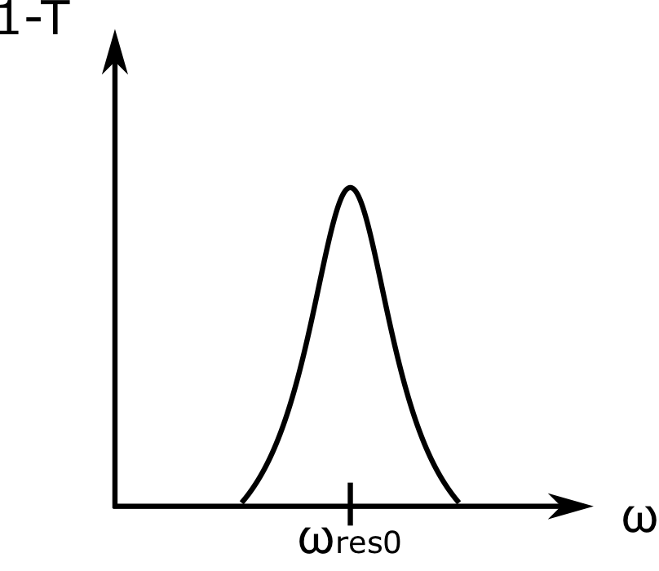
Nonlinear Optical Microcavities
All-optical switches in PhC semiconductor microcavities
GaAs Microcavity
Generation of free-carriers
➔ Frequency blue-shift
Signal
&
Control
Transmission
1 µm
C. Husko, Appl. Phys. Lett. 94, 021111 (2009)
Frequency
4

Slide 5
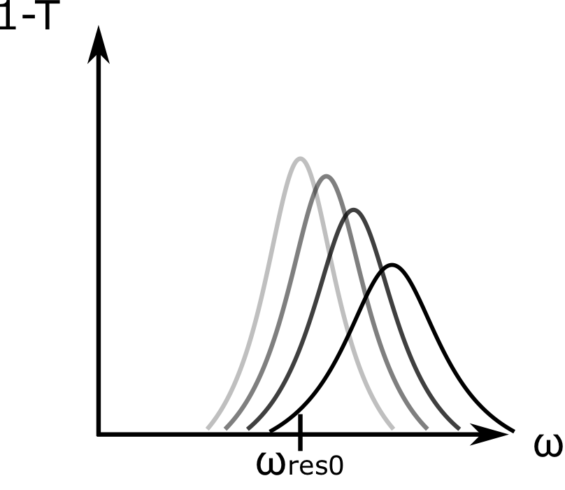
Nonlinear Optical Microcavities
All-optical switches in PhC semiconductor microcavities
GaAs Microcavity
Generation of free-carriers
➔ Frequency blue-shift
Signal
&
Control
Transmission
1 µm
C. Husko, Appl. Phys. Lett. 94, 021111 (2009)
Frequency
4

Slide 6
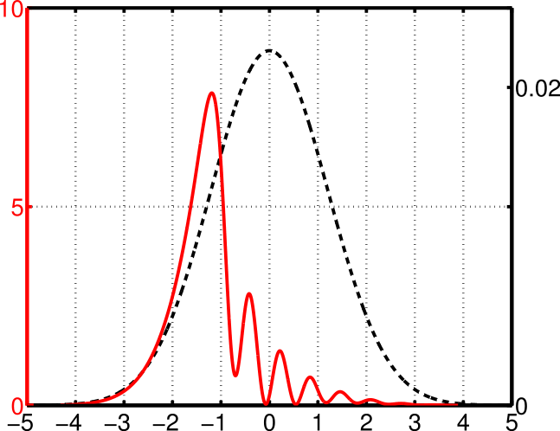
Nonlinear Optical Microcavities
All-optical switches in PhC semiconductor microcavities
GaAs Microcavity
Generation of free-carriers
➔ Frequency blue-shift
Signal
&
Control
Transmission
1 µm
C. Husko, Appl. Phys. Lett. 94, 021111 (2009)
Frequency detuning issues :
limitation in the coupling efficiency of the control pulse
Cavity enhancement effect is not maintained for the entire pulse duration
Ringing behavior : leads to a temporal distorsion of the pulse
Frequency
Power (a.u.)
Time
4
Notes:
Whereas the nonlinear refractive index change induced by the pulse front edge detunes the cavity resonance, it also contributes to a decrease of the coupling efﬁciency for the rest of the pulse. It means that only one part of the pulse energy is effective to perform the optical switching operation.

Slide 7
Nonlinear Optical Microcavities
QUESTION :
Is there a way to control the light-localization effect in a nonlinear optical resonator ?
ISSUES to be addressed
More efficient way to excite a cavity in nonlinear regime ?
Enhancement of the intra-cavity light-matter interaction ?
Any control on the NL freq. shift Δω_{NL} + intra-cavity fields dynamics ?
5

Slide 8
Nonlinear Optical Microcavities
QUESTION :
Is there a way to control the light-localization effect in a nonlinear optical resonator ?
ISSUES to be addressed
More efficient way to excite a cavity in nonlinear regime ?
Enhancement of the intra-cavity light-matter interaction ?
Any control on the NL freq. shift Δω_{NL} + intra-cavity fields dynamics ?
➔ Coherent excitation of atomic and molecular resonances
D. Meshulach, Nature 396, 239 (1998)
B. Chatel & B. Girard, in Femtosecond Laser Spectroscopy, Springer (2005)
5

Slide 9
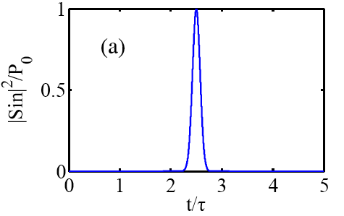
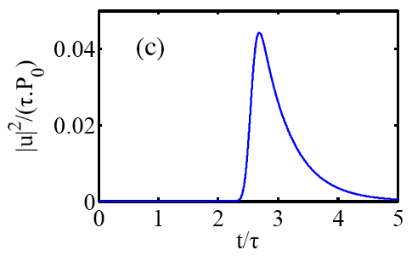
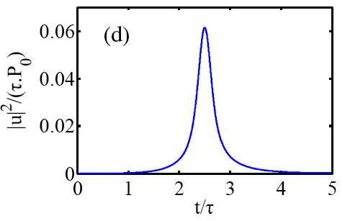
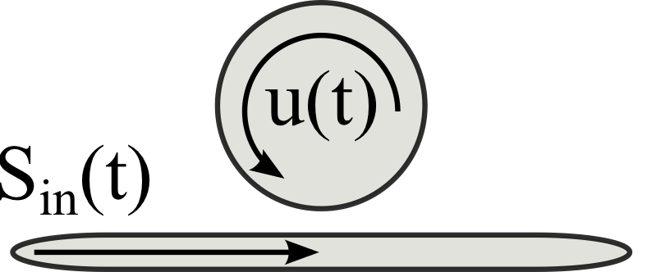
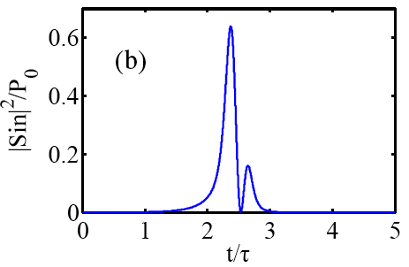
Coherent Control & Opt. Resonator
S. Sandhu et al., App. Phys. Lett. 96, 231108 (2010)
Input pulse
Intracavity pulse
6

Slide 10
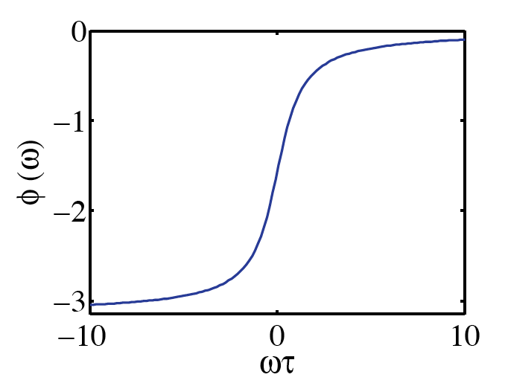
Coherent Control & Opt. Resonator
S. Sandhu et al., App. Phys. Lett. 96, 231108 (2010)
Input pulse
Intracavity pulse
Spectral phase = dispersion shape of the optical resonance
Enhancement of the intracavity peak energy
Application : bistable operation with reduced control power + phase switching operation
P. T. Kristensen et al. App. Phys. Lett. 102, 041107 (2013)
6

Slide 11

Coh. Excitation of a NL Microcavity
Silicon Microcavity
J. Oden et al., J. Europ. Opt. Soc. Rap. Public. 8, 13046 (2013)
7

Slide 12
Coh. Excitation of a NL Microcavity
Silicon Microcavity
J. Oden et al., J. Europ. Opt. Soc. Rap. Public. 8, 13046 (2013)
Refractive index variation
Nonlinear losses
Optical Kerr eﬀect
Free carrier refraction (FCR)
Two-photon absorption (TPA)
Free carrier absorption (FCA)
Frequency blue-shift
Transmission
7

Slide 13
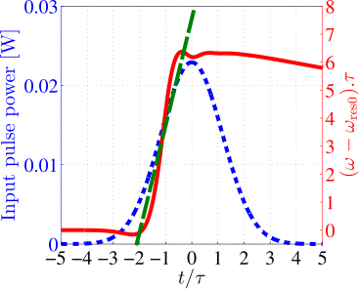
Coh. Excitation of a NL Microcavity
Silicon Microcavity
J. Oden et al., J. Europ. Opt. Soc. Rap. Public. 8, 13046 (2013)
Refractive index variation
Nonlinear losses
Optical Kerr eﬀect
Free carrier refraction (FCR)
Two-photon absorption (TPA)
Free carrier absorption (FCA)
Frequency blue-shift
Transmission
➔ Linear time variation of the cavity resonance
7
Notes:
accurately tailored chirped pulse, whose instantaneous frequency coincides with the nonlinear resonance drift, which allows the light to efﬁciently build-up inside the cavity

Slide 14
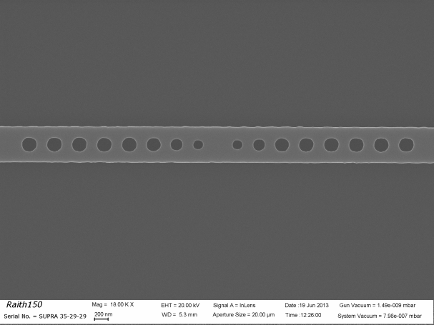
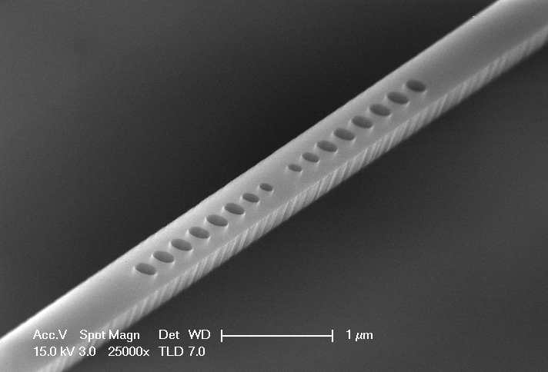
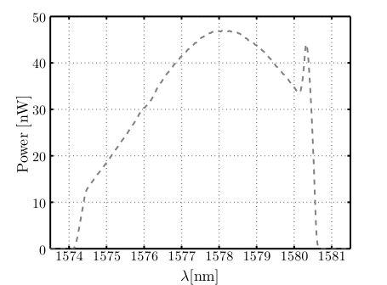
Coh. Excitation of a NL Microcavity
Silicon Microcavity
V_{cav} = 0.8(λ/n)³
Design: Fabry-Perot type cavity with two-tapered Bragg mirrors
Fabrication: Minerve @ IEF – Univ. Paris-Sud
Q=5260 ➔ τ_{cav}=4.4 ps
P. Velha et al., Appl. Phys. Lett. 89, 171121 (2006).
Δω₀
1 µm
7

Slide 15
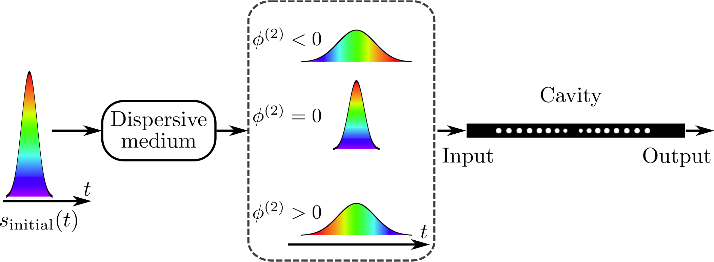
Coh. Excitation of a NL Microcavity
Silicon Microcavity
Design: Fabry-Perot type cavity with two-tapered Bragg mirrors
Fabrication: Minerve @ IEF – Univ. Paris-Sud
P. Velha et al., Appl. Phys. Lett. 89, 171121 (2006).
➔ Coherent excitation using a chirped pulse
ω
Time
Time
7

Slide 16
Coh. Excitation of a NL Microcavity
Silicon Microcavity
Design: Fabry-Perot type cavity with two-tapered Bragg mirrors
Fabrication: Minerve @ IEF – Univ. Paris-Sud
P. Velha et al., Appl. Phys. Lett. 89, 171121 (2006).
➔ Coherent excitation using a chirped pulse
ω
α
Time
Time
7

Slide 17
Coh. Excitation of a NL Microcavity
Silicon Microcavity
Design: Fabry-Perot type cavity with two-tapered Bragg mirrors
Fabrication: Minerve @ IEF – Univ. Paris-Sud
P. Velha et al., Appl. Phys. Lett. 89, 171121 (2006).
➔ Coherent excitation using a chirped pulse
ω
α
Time
Time
Dispersion Coefficient
Absorbed Energy
7

Slide 18
Coh. Excitation of a NL Microcavity
Silicon Microcavity
➔ Coherent excitation using a chirped pulse
7

Slide 19
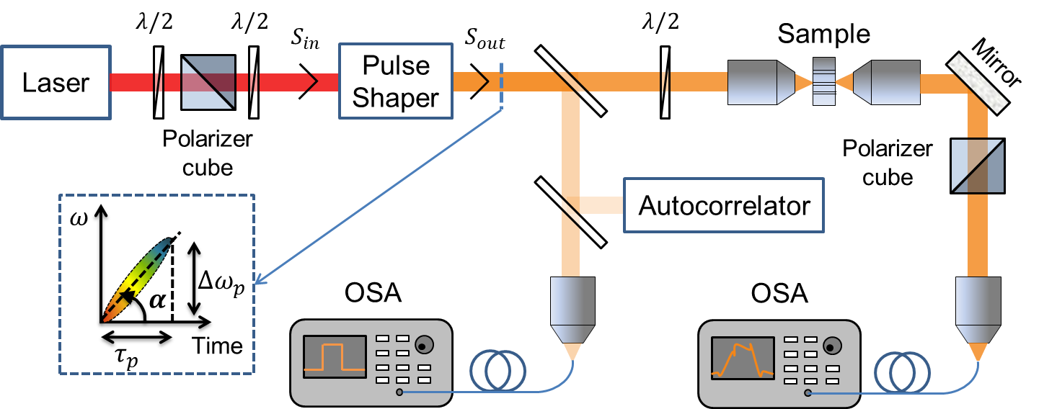
Coherent Excitation Set-up
150 fs pulses
@ 50 MHz
Grating-based pulse stretcher
O.E. Martinez, IEEE JQE 23, 59 (1987)
8

Slide 20
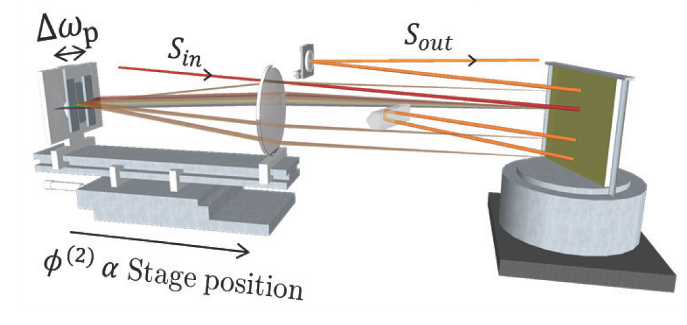
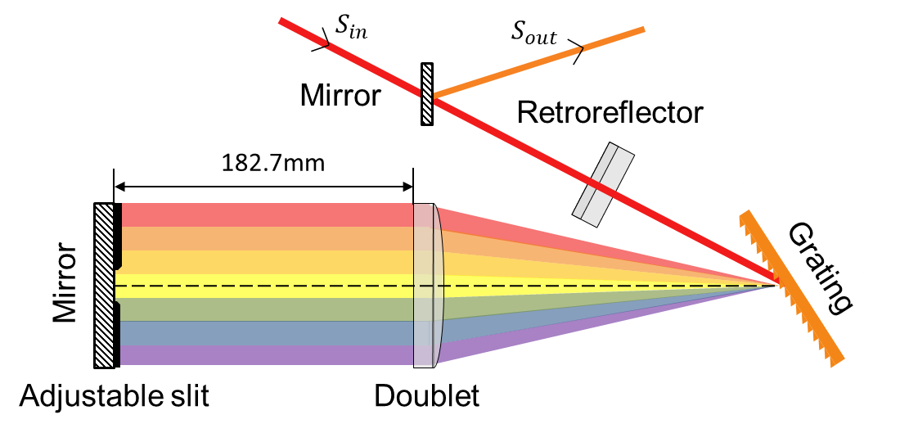
Coherent Excitation Set-up
150 fs pulses
@ 50 MHz
Grating-based pulse stretcher
O.E. Martinez, IEEE JQE 23, 59 (1987)
Pulse shaper
8

Slide 21
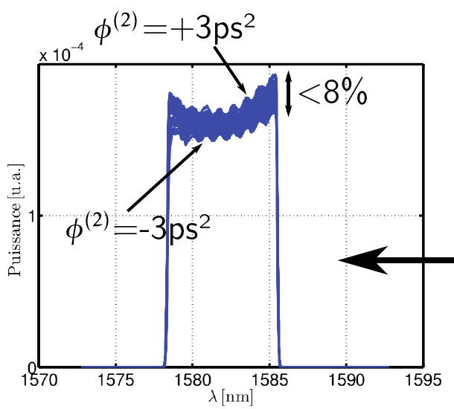
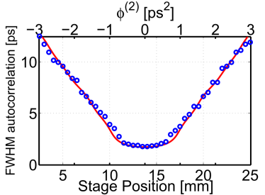
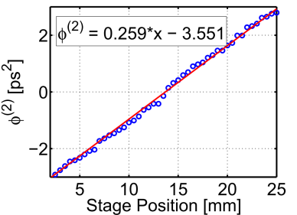
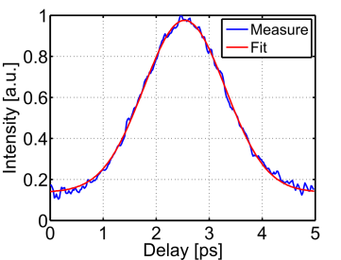
Coherent Excitation Set-up
150 fs pulses
@ 50 MHz
Grating-based pulse stretcher
O.E. Martinez, IEEE JQE 23, 59 (1987)
Power [a.u.]
Wavelength [nm]
8

Slide 22
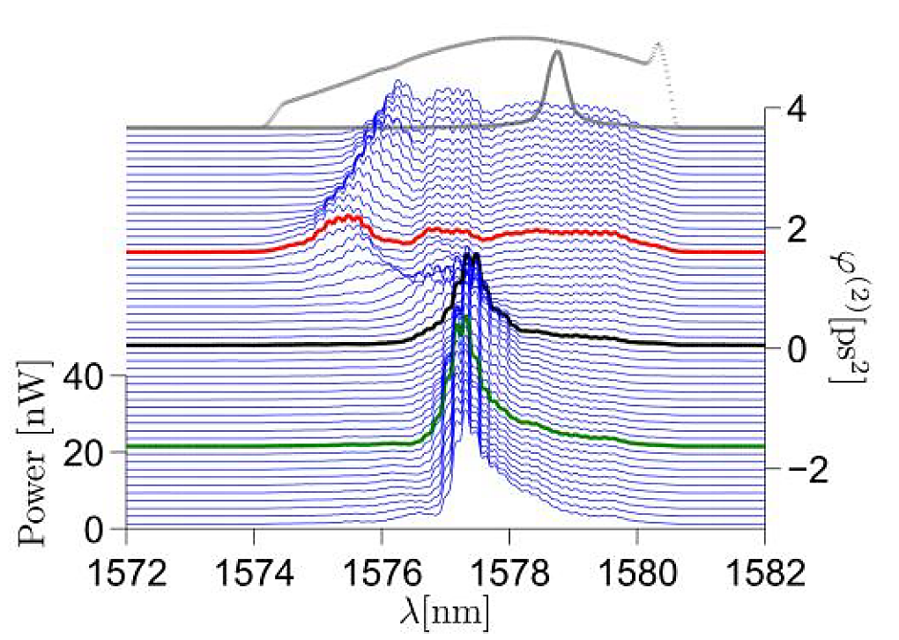
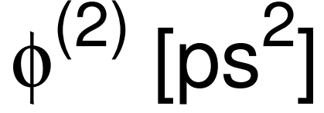
Coh. Excitation : Exp. Demonstration
Transmission spectra with chirp varying from ϕ⁽²⁾= -3.5 to +3.5 ps².
U_{incident}= 3 pJ = Cste
9

Slide 23
Coh. Excitation : Exp. Demonstration
Transmission spectra with chirp varying from ϕ⁽²⁾= -3.5 to +3.5 ps².
U_{incident}= 3 pJ = Cste
ϕ⁽²⁾=0 ps²
Equal Pulse duration
5.7 ps (Autocorr = 8 ps)
ϕ⁽²⁾=+1.6 ps²
ϕ⁽²⁾=-1.6 ps²
First exp. demonstration :
Coherent Excitation of a NL µcavity
9

Slide 24
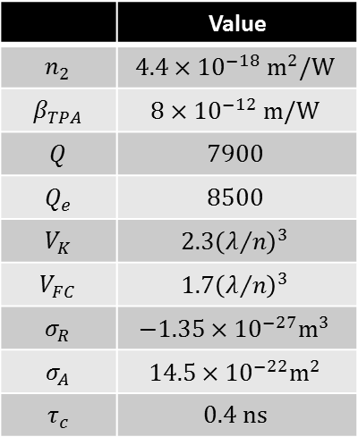
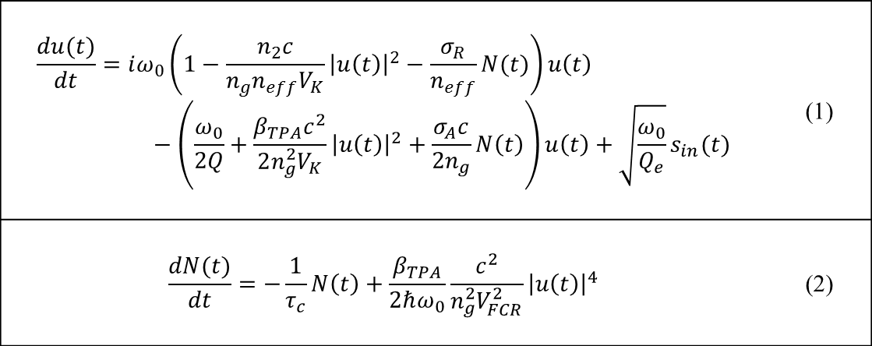
Coh. Excitation : Num. Model
$$\frac{du(t)}{dt}=iω_{0}\left(1−\frac{n_{2}c}{n_{g}n_{eff}V_{K}}{\left|u\left(t\right)\right|}^{2}−\frac{σ_{R}}{n_{eff}}N(t)\right)u\left(t\right)−\left(\frac{ω_{0}}{2Q}+\frac{β_{TPA}c^{2}}{2n_{g}^{2}V_{K}}{\left|u\left(t\right)\right|}^{2}+\frac{σ_{A}c}{2n_{g}}N\left(t\right)\right)u\left(t\right)+\sqrt{\frac{ω_{0}}{Q_{e}}}s_{in}(t)$$ | (1)
$$\frac{dN(t)}{dt}=−\frac{1}{τ_{c}}N\left(t\right)+\frac{β_{TPA}}{2ℏω_{0}}\frac{c^{2}}{n_{g}^{2}V_{FCR}^{2}}{\left|u\left(t\right)\right|}^{4}$$ | (2)
Paul Barclay et. al,
Opt. Express 13, 801-820 (2005)
 | Value
$$n_{2}$$ | $$4.4×{10}^{−18} m^{2}/W$$
$$β_{TPA}$$ | $$8×{10}^{−12} m/W$$
$$Q$$ | $$7900$$
$$Q_{e}$$ | $$8500$$
$$V_{K}$$ | $$2.3{\left(λ/n\right)}^{3}$$
$$V_{FC}$$ | $$1.7{\left(λ/n\right)}^{3}$$
$$σ_{R}$$ | $$−1.35×{10}^{−27}m^{3}$$
$$σ_{A}$$ | $$14.5×{10}^{−22}m^{2}$$
$$τ_{c}$$ | $$0.4 ns$$
10

Slide 25
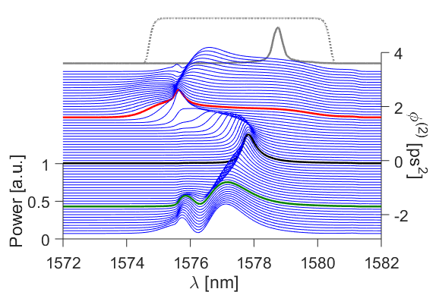
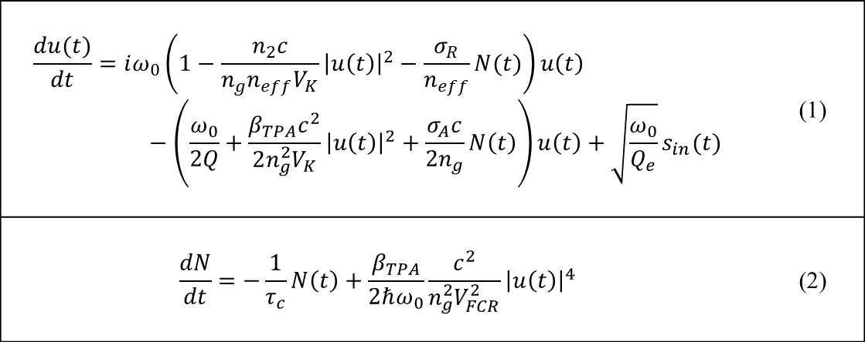
Coh. Excitation : Num. Model
$$\frac{du(t)}{dt}=iω_{0}\left(1−\frac{n_{2}c}{n_{g}n_{eff}V_{K}}{\left|u\left(t\right)\right|}^{2}−\frac{σ_{R}}{n_{eff}}N(t)\right)u\left(t\right)−\left(\frac{ω_{0}}{2Q}+\frac{β_{TPA}c^{2}}{2n_{g}^{2}V_{K}}{\left|u\left(t\right)\right|}^{2}+\frac{σ_{A}c}{2n_{g}}N\left(t\right)\right)u\left(t\right)+\sqrt{\frac{ω_{0}}{Q_{e}}}s_{in}(t)$$ | (1)
$$\frac{dN}{dt}=−\frac{1}{τ_{c}}N\left(t\right)+\frac{β_{TPA}}{2ℏω_{0}}\frac{c^{2}}{n_{g}^{2}V_{FCR}^{2}}{\left|u\left(t\right)\right|}^{4}$$ | (2)
Paul Barclay et. al,
Opt. Express 13, 801-820 (2005)
Effect of 2.5 mm
waveguide
4.5 W injected
 | Value
$$n_{2}$$ | $$4.4×{10}^{−18} m^{2}/W$$
$$β_{TPA}$$ | $$8×{10}^{−12} m/W$$
$$Q$$ | $$7900$$
$$Q_{e}$$ | $$8500$$
$$V_{K}$$ | $$2.3{\left(λ/n\right)}^{3}$$
$$V_{FC}$$ | $$1.7{\left(λ/n\right)}^{3}$$
$$σ_{R}$$ | $$−1.35×{10}^{−27}m^{3}$$
$$σ_{A}$$ | $$14.5×{10}^{−22}m^{2}$$
$$τ_{c}$$ | $$0.4 ns$$
10

Slide 26
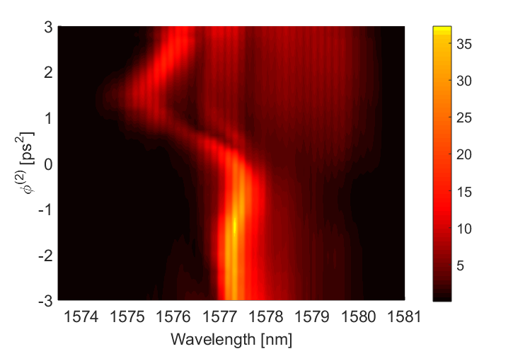
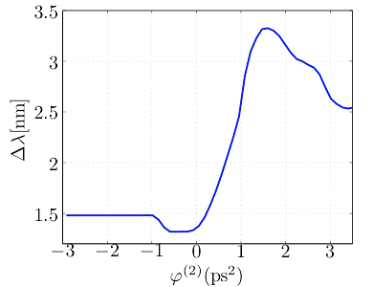
Coh. Excitation
Transmission spectra with chirp varying from ϕ⁽²⁾= -3.0 to +3.0 ps².
U_{incident}= 3 pJ = Cste
Equal Pulse duration
5.7 ps (Autocorr = 8 ps)
Nonlinear Frequency shift
nW
Carrier Density
× 2
First exp. demonstration :
Coherent Excitation of a NL µcavity
Enhanced nonlinear interaction
10

Slide 27
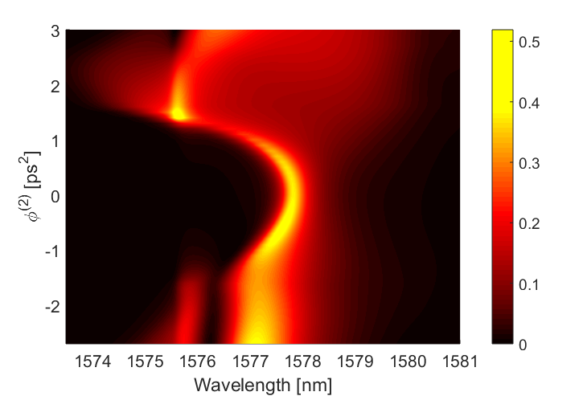
Coh. Excitation
Transmission spectra with chirp varying from ϕ⁽²⁾= -3.0 to +3.0 ps².
U_{incident}= 3 pJ = Cste
a.u.
nW
Simulation
First exp. demonstration :
Coherent Excitation of a NL µcavity
Enhanced nonlinear interaction
10

Slide 28
Conclusion
By controling the linear chirp ➔ COHERENT EXCITATION
Experiment
ω_{cav.}
time
Nonlinear interaction enhancement
Free carrier density x 2
Cavity Bandwidth x 20
Simulations
First Experimental Demonstration of the Coherent Excitation of a NL Opt. Resonator
Capability to manipulate the optical bandwidth & the nonlinear dynamics of a cavity
11

Slide 29
Perspectives
More complex pulse shaping (Amplitude & Phase) using SLM based pulse shaper
Deeper exploitation of the model
Experimental study of the nonlinear cavity dynamics
Application for :
ACTIVE microcavities
Coupled resonators
Acknowledgements
Scholarship from the Ministry of Higher Education and Research (France).
12

Slide 30
NL Cavity Transmission
INPUT PULSE = Fourier-Limit pulse (ϕ⁽²⁾=0)
Δλ_{P} = 5.7 nm (≈20×Δλ₀ ) ➔ τ_{corr}=2 ps
Injected Energy = 3 pJ
(x12)
9

Slide 31
NL Cavity Transmission
INPUT PULSE = Fourier-Limit pulse (ϕ⁽²⁾=0)
Δλ_{P} = 5.7 nm (≈20×Δλ₀ ) ➔ τ_{corr}=2 ps
Injected Energy = 3 pJ
(x12)
blue-shift of the cavity resonance : Δλ_{NL} = 1.4 nm
9

Slide 32
Coh. Excitation
Transmission spectra with chirp varying from ϕ⁽²⁾= -3.5 to +3.5 ps².
U_{incident}= 3 pJ = Cste
ϕ⁽²⁾=0 ps²
Equal Pulse duration
5.7 ps (Autocorr = 8 ps)
ϕ⁽²⁾=+1.6 ps²
ϕ⁽²⁾=-1.6 ps²
First exp. demonstration :
Coherent Excitation of a NL µcavity
10

Slide 33
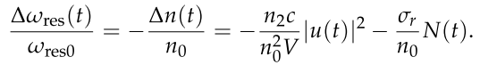
0.4 pJ.
Δωp = 30 ω/Q
φ(2)= τp /Δωp = Q2/(30 ω2)=+1.3 ps2

